Slide 1
PTM Invest holding a.s.

Slide 2
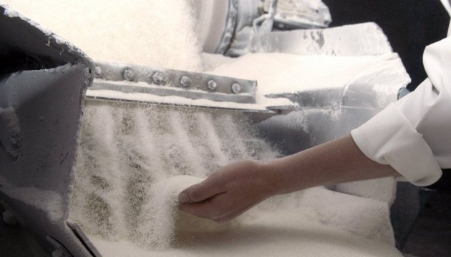
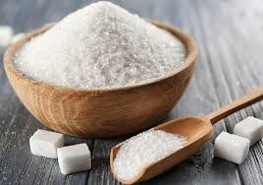
Cooperation with us has a number of advantages
Geographical location.
High quality
Low costs
Trade preferences
Variety of assortment
- 121 $/1000 kg

Slide 3
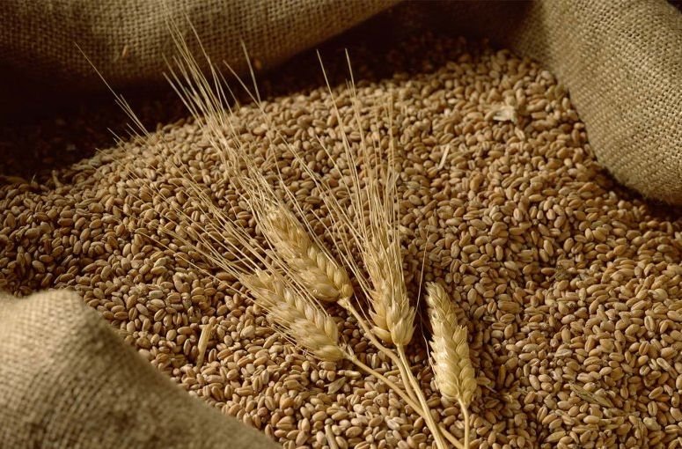
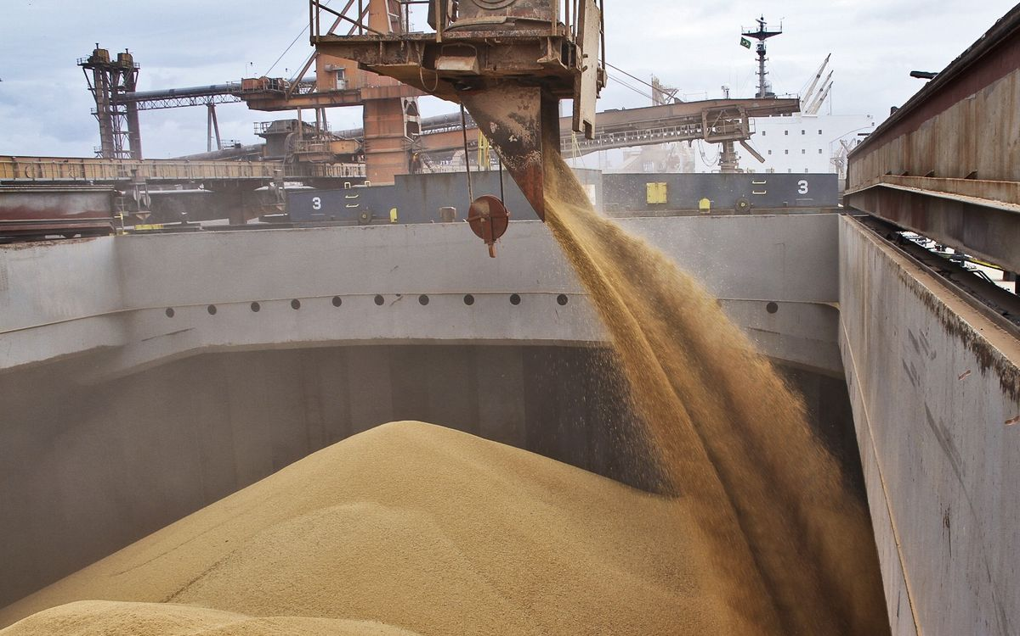
Cooperation with us has a number of advantages
Geographical location.
High quality
Low costs
Trade preferences
Variety of assortment
- 155 $/1000 kg
The experience and professionalism of our specialists allow the company to constantly expand the geography of purchases and sales. We are always open to constructive suggestions.

Slide 4
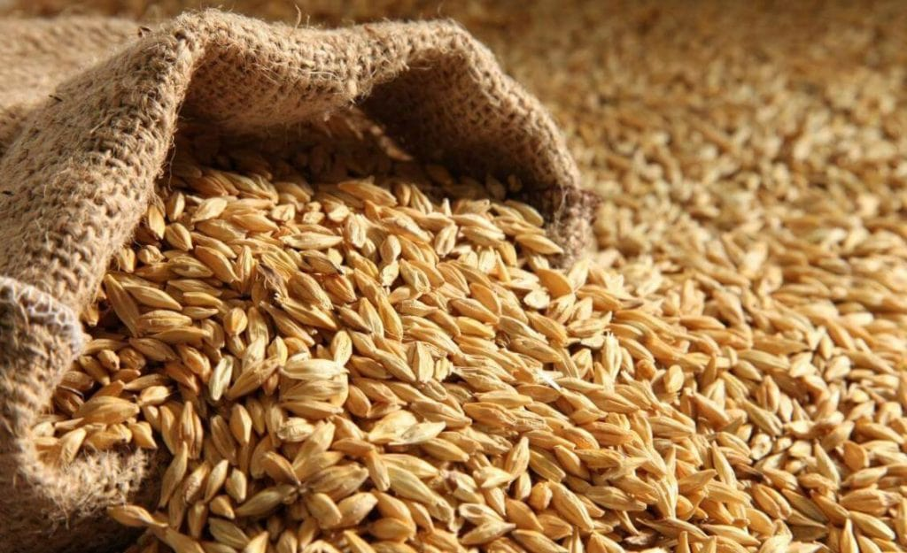
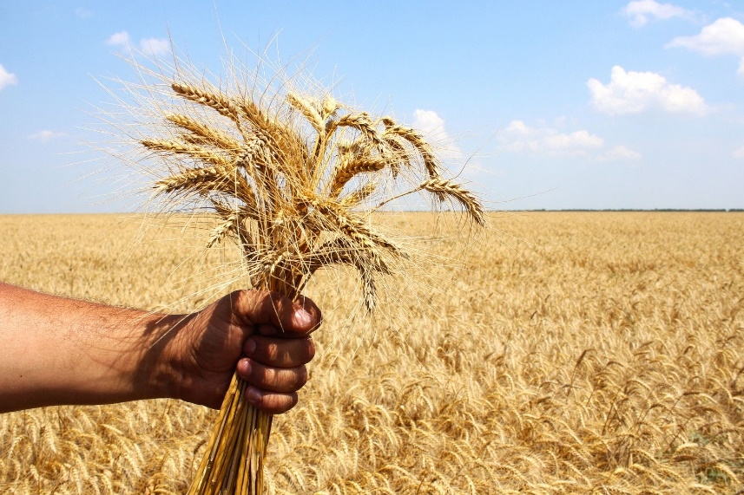
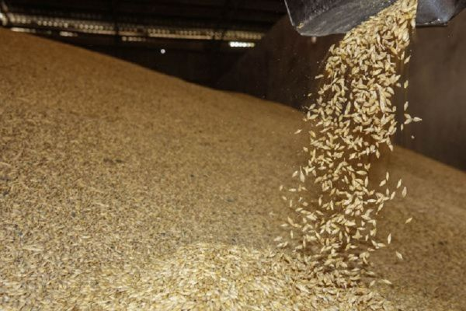
Cooperation with us has a number of advantages
Geographical location.
High quality
Low costs
Trade preferences
Variety of assortment
- 61 $/1000 kg

Slide 5
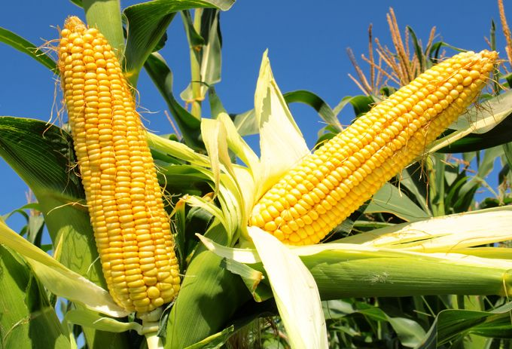
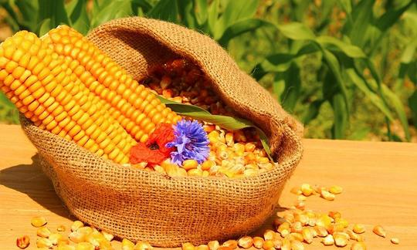
Principles of interaction with suppliers and buyers :
Striving for common goals.
Support and assistance in
Focus on specific results development.
Responsibility for your contribution to common
We do more than we stipulate achievements
in the obligations.
- 63 $/1000 kg

Slide 6
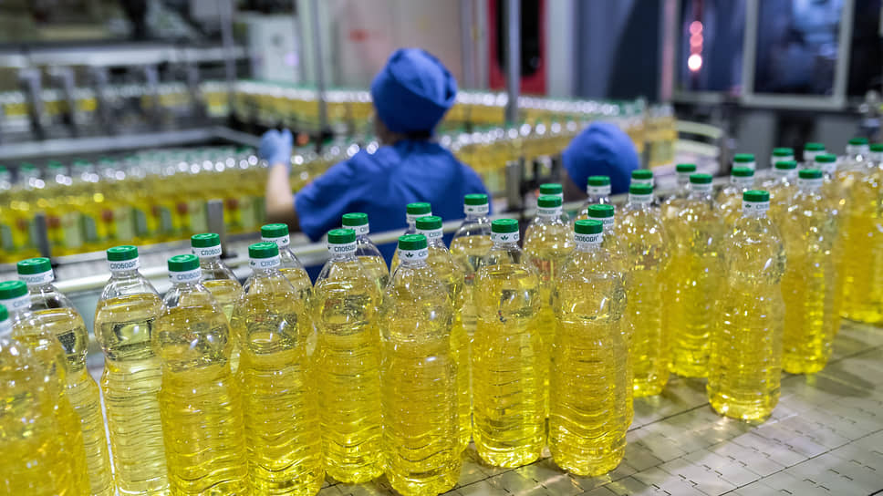
Unrefined. Filling (including in Flexi tanks)
For today's multicultural possession, we can transform the great and high-oleic dormouse, as well as rapak, soybean talon.
Refined deodorized frozen. Pouring and bottling
Volume | 0,9 L (828 gr). | 1 L (920 gr) | 5 L (4 600 gr)
Quantity | 30,510 bottles (1 container 40 feet); Quantity - 24,000 bottles in a car lot; Quantity - 15 bottles in a box; | 27,000 bottles (1 container); | 5,712 bottles (1 container)
Price | USD – 1,45 | USD – 1,45 | USD – 7,15
Trademark | maybe your TM. | maybe your TM. | maybe your TM.
- 177 $/1000 liter

Slide 7
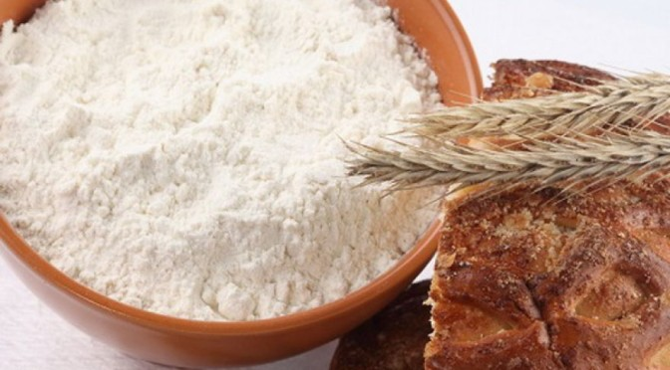
We offer the following range of flour
flour type Т – 600. flour type Т – 450 flour type Т – 450
Our company guarantees high quality and safety of products, thanks to the implementation and operation of a quality and food safety management system that meets modern norms and standards.
Cooperation with us has a number of advantages
Geographical location.
High quality
Low costs
Trade preferences
Variety of assortment
- 3 K$/1000 kg

Slide 8
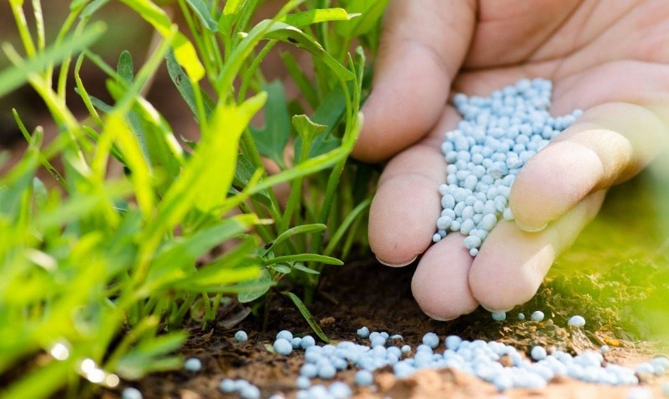
Cooperation with us has a number of advantages
Geographical location.
High quality
Low costs
Trade preferences
Variety of assortment
- 234 $/1000 kg

Slide 9
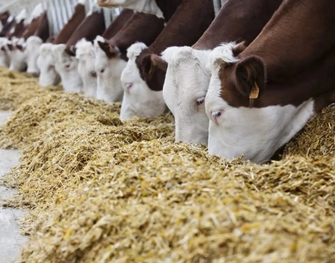
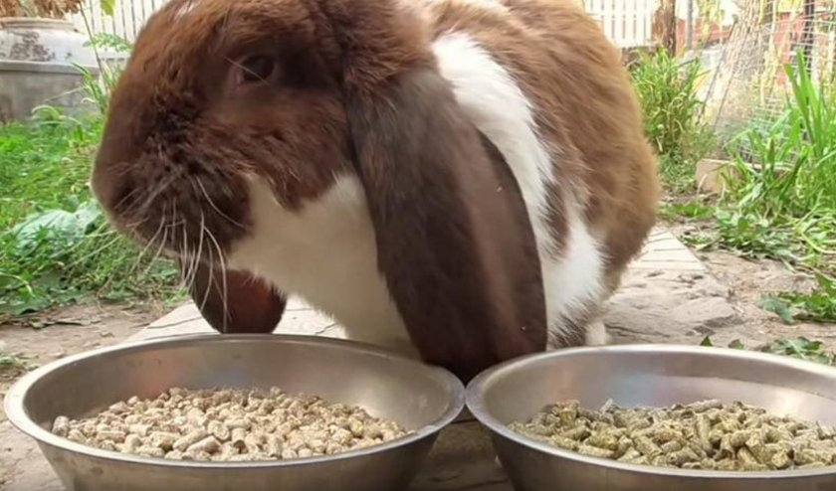
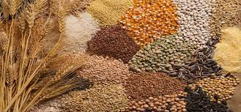
complete combined feed for cattle breeding
Compound feed concentrate (a mixture of various feeds, suitable for all groups of animals, contains a high content of minerals, protein, microadditives)
Complete feed (completely provides animals with all the necessary nutrients and minerals)
complete combined feed for birds
combined feed for rabbits, nutria and other small animals
- 75 $/1000 kg
Cooperation with us has a number of advantages
Geographical location.
High quality
Low costs
Trade preferences
Variety of assortment

Slide 10
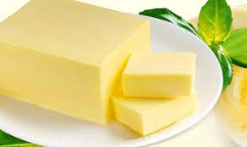
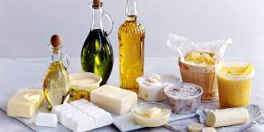
butter
margarine
other edible fats incl. for confectionery
Principles of interaction with suppliers and buyers :
Striving for common goals.
Support and assistance in
Focus on specific results development.
Responsibility for your contribution to common
We do more than we stipulate achievements
in the obligations.
- 115 $/100 kg

Slide 11
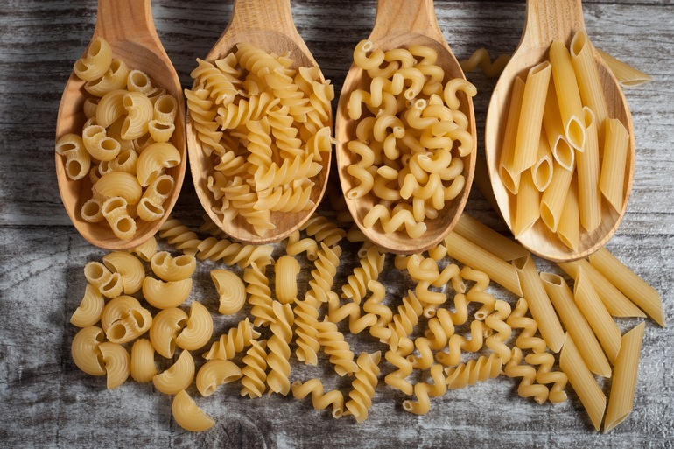
spaghetti
horns
noodles
pasta in assortment
Principles of interaction with suppliers and buyers :
Striving for common goals.
Support and assistance in
Focus on specific results development.
Responsibility for your contribution to common
We do more than we stipulate achievements
in the obligations.
- 22 $/100 kg

Slide 12
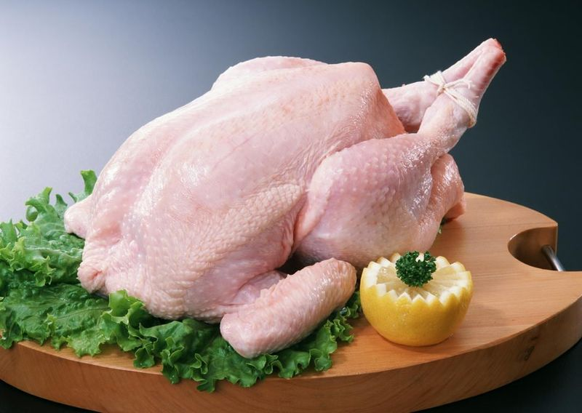
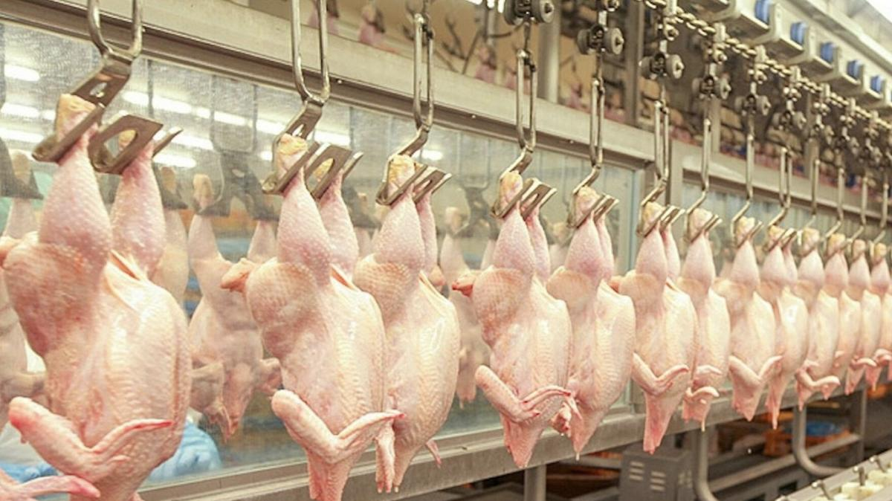
Cooperation with us has a number of advantages
Geographical location.
High quality
Low costs
Trade preferences
Variety of assortment
- 38 $/100 kg

Slide 13
Thank you for the opportunity to present. Contact our company.

Slide 14
Contacts:
Residence: PTM Invest holding a.s. Za Stodolou 144 25101 Praha – Modletice Česká republika
Office: Drtinova 221/10 503 11 Hradec Králové Česká republika
CEO: +420 776 271 800; miroslav.panacek@ptmas.cz
Executive assistant: +420 778 744 581; info@ptmas.cz
www.ptmas.cz

